Slide 1
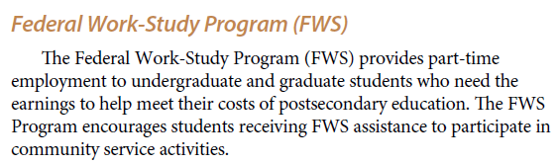
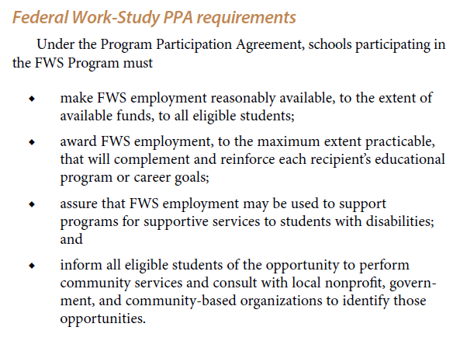


Slide 2
Federal Work-Study Supervisor Training
Session 2: Candidate Selection, Onboarding, & Tracking
26 July 2017
Office of Scholarships & Student Aid
University of North Carolina at Chapel Hill

Slide 3
Overview of Today’s Session
  Application review
  Interviewing
  Hiring
  Onboarding
  Time/payroll tracking
  Reminders and Updates
  Future Sessions

Slide 4
Application Review

Slide 5
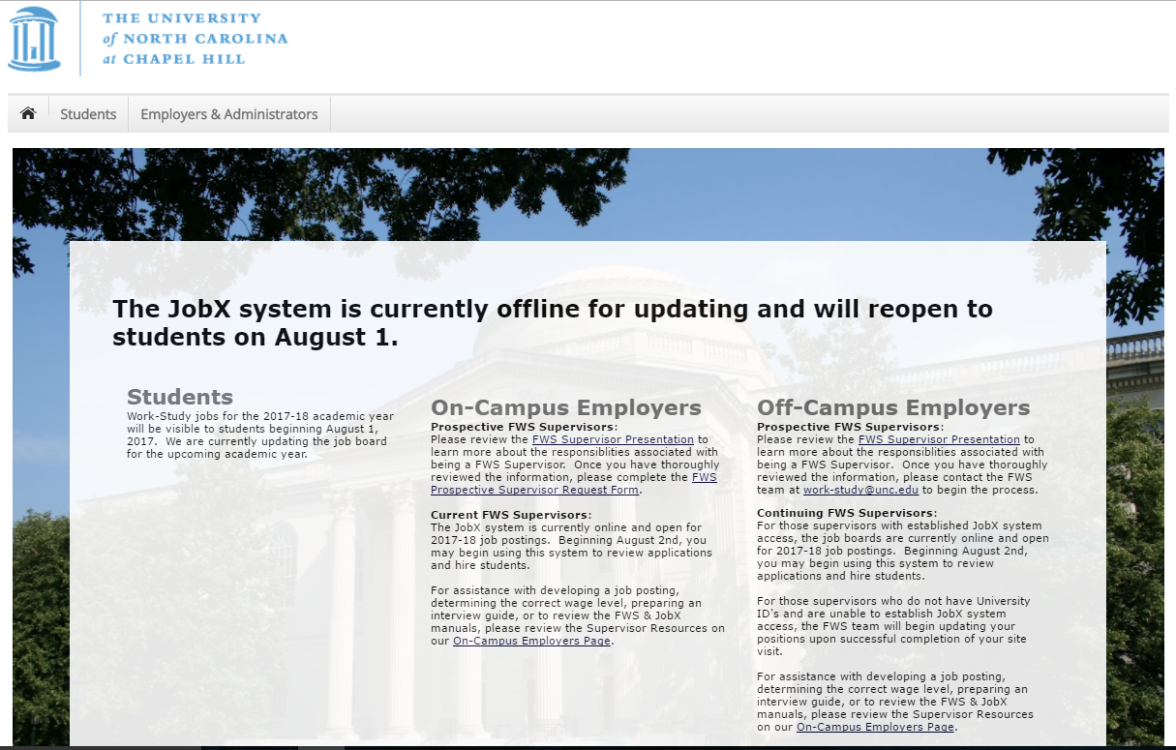
1: Log into JobX (https://unc.studentemployment.ngwebsolutions.com)

Slide 6
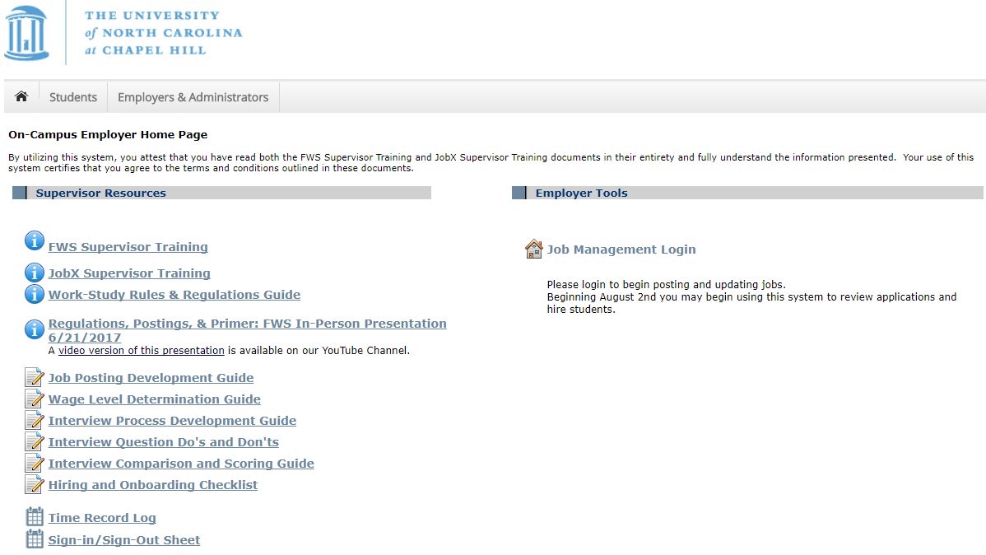
2: Log into the Job Management Section

Slide 7
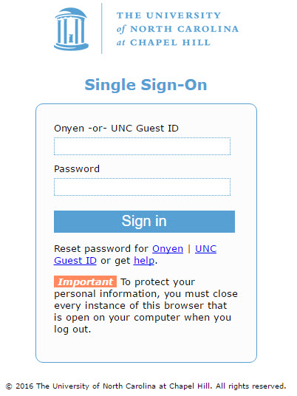
3: Sign in with your ONYEN & password

Slide 8
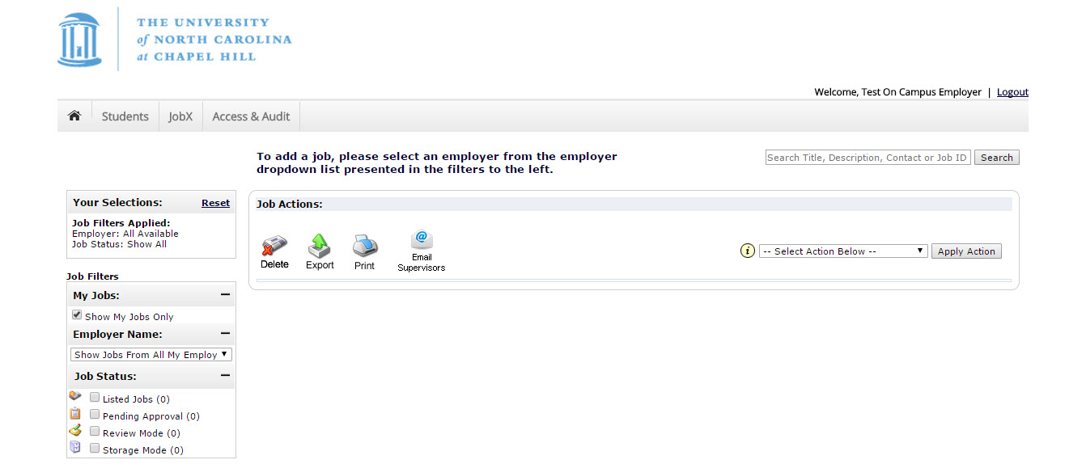
4: Select your department

Slide 9
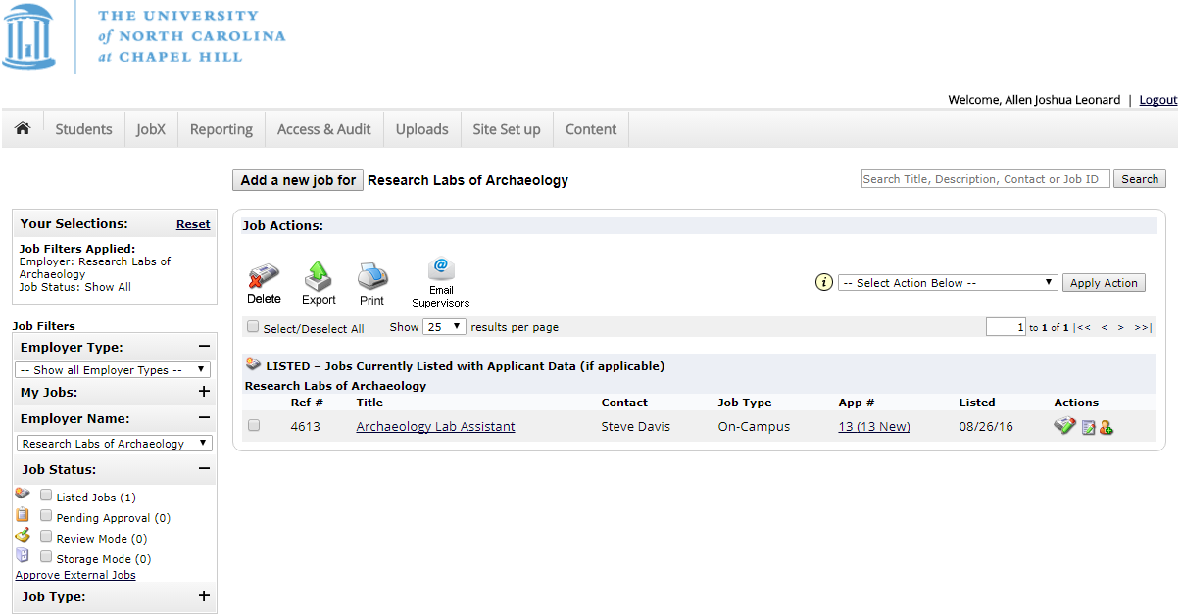
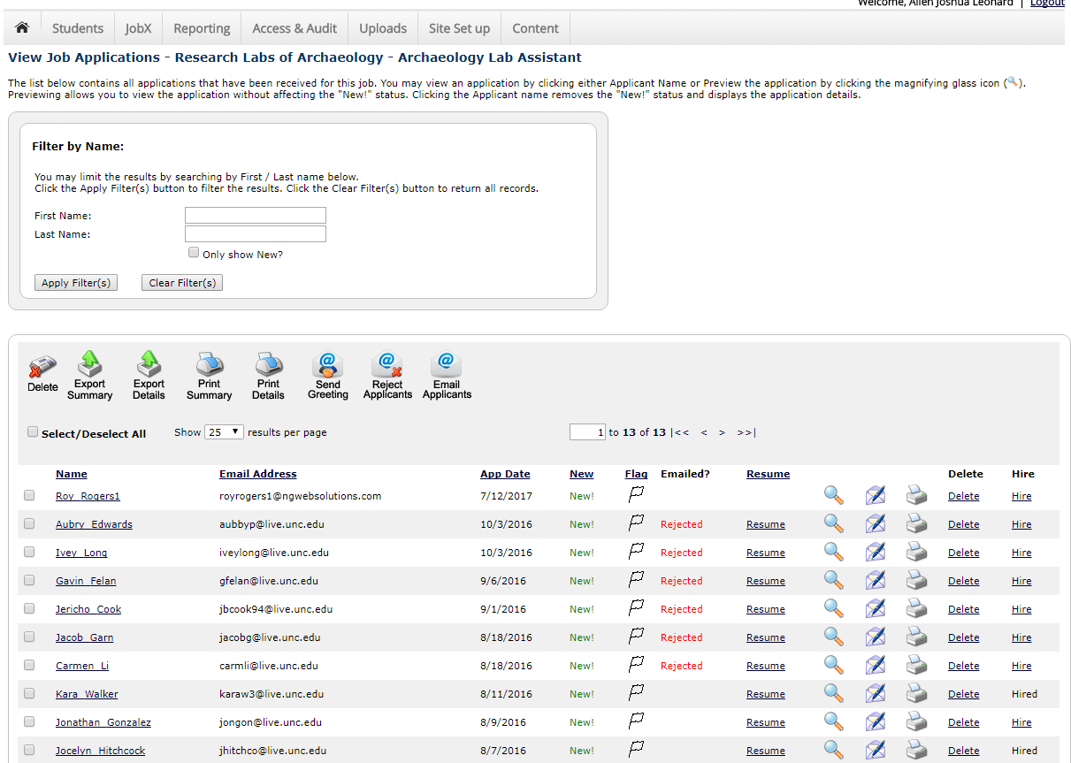
5: Log into application section

Slide 10
6: Review Applications
Filter
Act
View Data

Slide 11
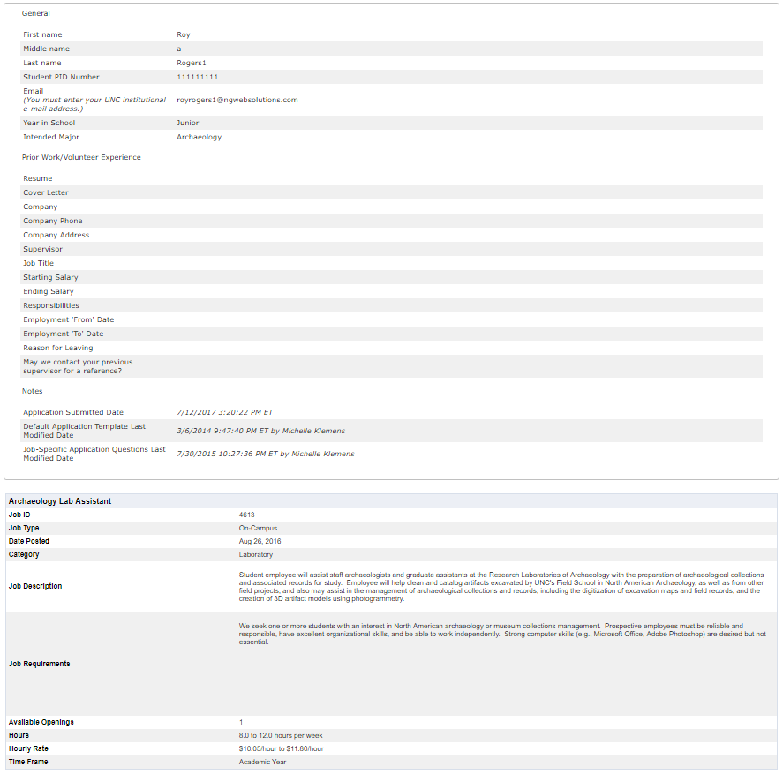
1. To view applicant data in full page mode
3. To view resume/cover letter
2. To view applicant data in preview mode
4. To flag candidate for consideration
5. To remove candidate from consideration

Slide 12
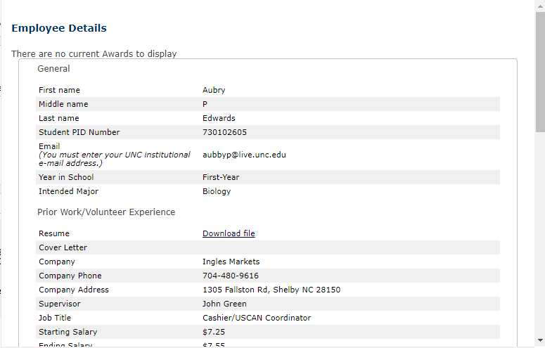
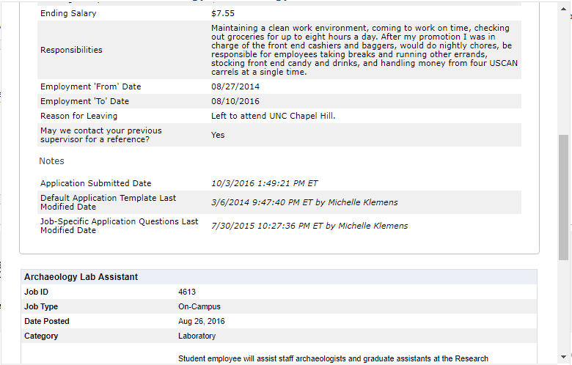
1. To view applicant data in full page mode
3. To view resume/cover letter
2. To view applicant data in preview mode
4. To flag candidate for consideration
5. To remove candidate from consideration

Slide 13
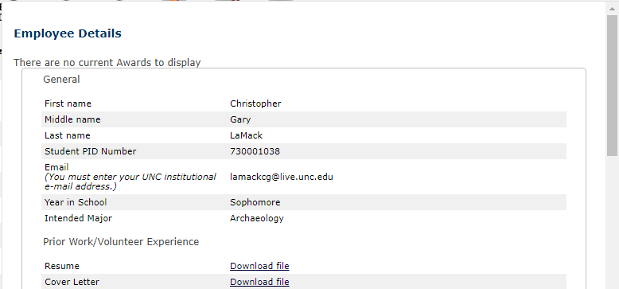
1. To view applicant data in full page mode
3. To view resume/cover letter
2. To view applicant data in preview mode
4. To flag candidate for consideration
5. To remove candidate from consideration

Slide 14
1. To view applicant data in full page mode
3. To view resume/cover letter
2. To view applicant data in preview mode
4. To flag candidate for consideration
5. To remove candidate from consideration

Slide 15

1. To view applicant data in full page mode
3. To view resume/cover letter
2. To view applicant data in preview mode
4. To flag candidate for consideration
5. To remove candidate from consideration

Slide 16
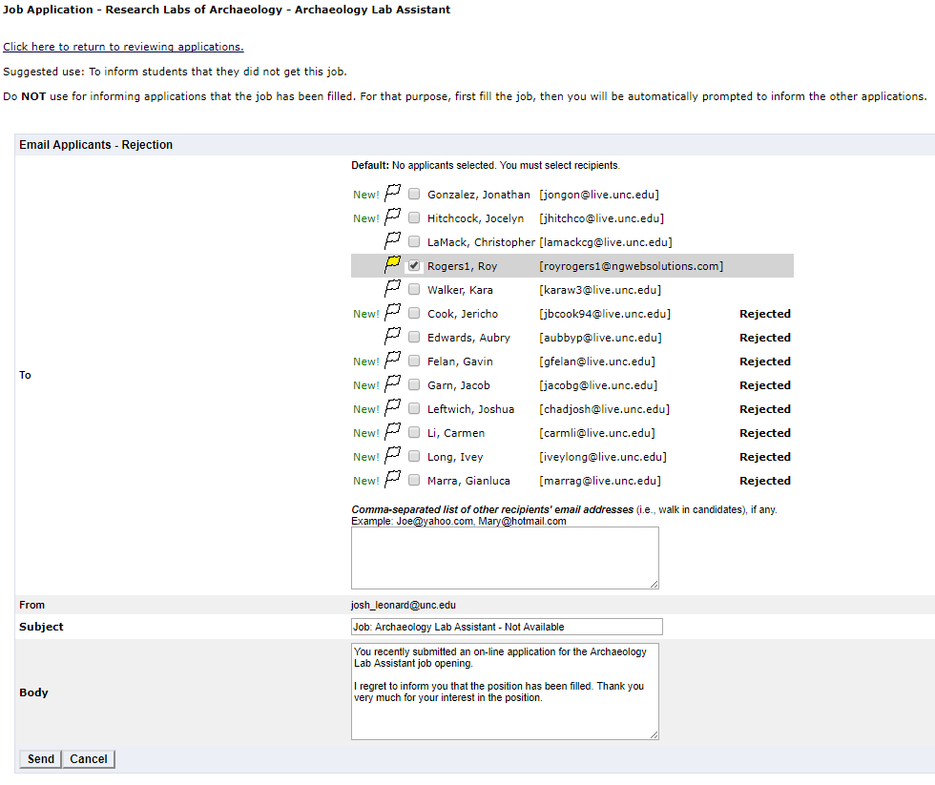

Slide 17

Interviewing

Slide 19
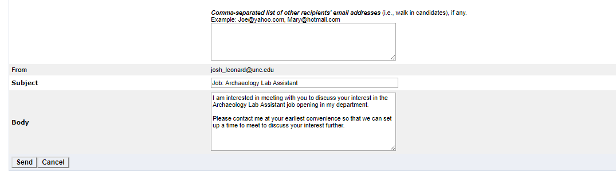

Slide 20
Interviews
Purpose
  Provide applicants the chance to learn more about the position and staff
  Provide supervisor the chance to better assess the candidate for fit
  Provide both parties an opportunity to ask questions
REQUIRED for new hires and returners moving to new positions
OPTIONAL for returns staying in the same position with same duties
Valid Formats:
  In Person
  Telephone
  Via Internet
  Facetime
  Etc.

Slide 21
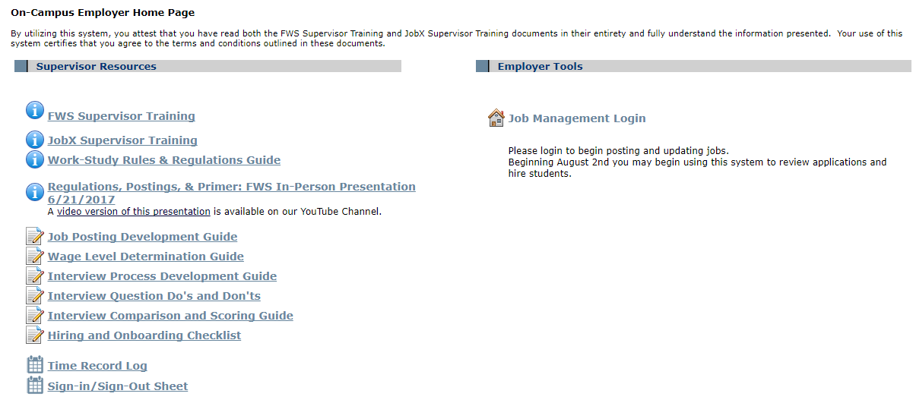
Interview Tools
How to turn your job posting into a cohesive interview
Topics you can’t ask about during an interview
Scoring methodology to make good comparisons

Slide 22
Interviews (Short Version)
  Creating The Interview
    Review your job posting
    Extract the most important parts (duties, skills, tasks, etc.)
    Distill them into your characteristics for measurement
    Develop question(s) for each characteristic
    Review and improve questions (ensure the questions don’t cover protected topics)
    Place in order
  Create An Evaluation System
    Determine how important each category is [choose percentages]
    Determine how to score each category [1-5 Likert Scale]
    Conduct interviews
  Score and Select
    Score interview & calculate final score
    Compare scores select best candidate(s)

Slide 23
Score
3
Score
5
Score
4
Score
3
Score
3
Score
1
Score
2
Category Weight
10%
Category Weight
18%
Category Weight
10%
Category Weight
12%
Category Weight
15%
Category Weight
20%
Category Weight
15%
Section Score
0.3
Section Score
0.9
Section Score
0.4
Section Score
0.36
Section Score
0.45
Section Score
0.2
Section Score
0.3
Job Posting
Creating the Interview
Score and Select
Question 1
  1 - 2 - 3 - 4 - 5
Question 1
  1 - 2 - 3
Characteristic 1
Characteristic 2
Characteristic 4
Characteristic 5
Characteristic 6
Characteristic 7
Ability-> Char. 2
Final Score
4.25
Final Score
3.57
Duty -> Char. 1
Skill -> Char. 1
Duty -> Char. 2
Know. -> Char. 3
Duty -> Char. 3
Other factor -> Char. 4
Job Duties
Question 2
Knowledge, Skills, Abilities
  1 - 2 - 3 - 4 - 5
Question 2
  1 - 2 - 3
C1 10%
C2 18%
C3 10%
C4 12%
C5 15%
C6 20%
C7 15%
Question 3
Other Factors
Question
1
  1 - 2 - 3 - 4 - 5
Question 3
  1 - 2 - 3
Question
2
Question
3
Final Score
2.91
Question 4
  1 - 2 - 3 - 4 - 5
Question 4
  1 - 2 - 3
Create An Eval System
Final Score
2.83
Review
▼
Improve
▼
Structure for Interview
Question 5
  1 - 2 - 3 - 4 - 5
Question 5
  1 - 2 - 3
Characteristics
Question 6
  1 - 2 - 3 - 4 - 5
Question 6
  1 - 2 - 3
Question 7
  1 - 2 - 3 - 4 - 5
Question 7
  1 - 2 - 3

Slide 24

Hiring

Slide 25
Hiring
Extend a job offer
  Pro Tip: call the student and follow up with a written offer
  As a best practice, you’ll want to include the following items in your offer.
    The name of the position & JobX job ID
    The academic term(s) during which the student will be employed
    A wage rate and estimated number of hours per week
    A deadline by which the applicant needs to give you their decision
    A method by which the applicant can reach out if they have questions
    Signature, date, and PID lines for student to complete
  You should collect a written confirmation from the student
Once you have a reply, you’ll need to update JobX to officially hire the student
If this hire fills your last vacancy, you’ll need to release the other candidates

Slide 26
To Hire A Candidate(s) In JobX

Slide 27
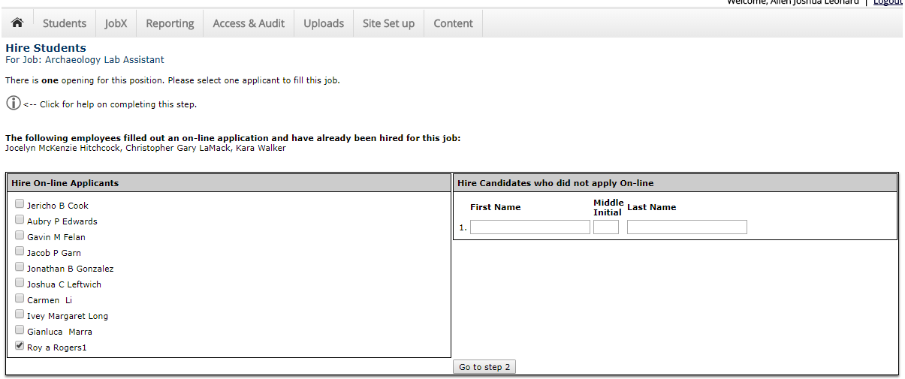

Slide 28
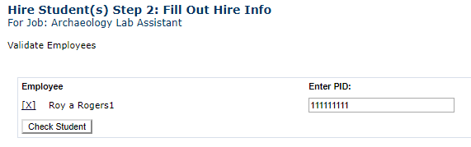
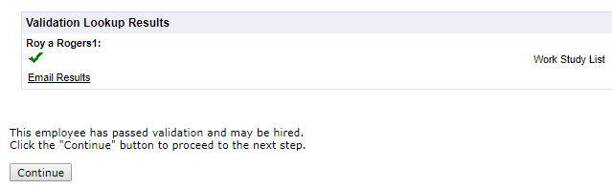
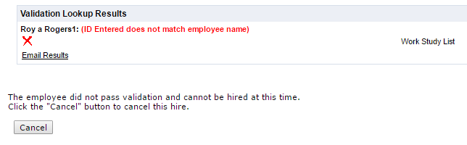

Slide 29
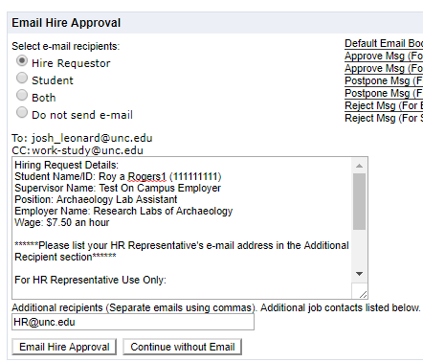
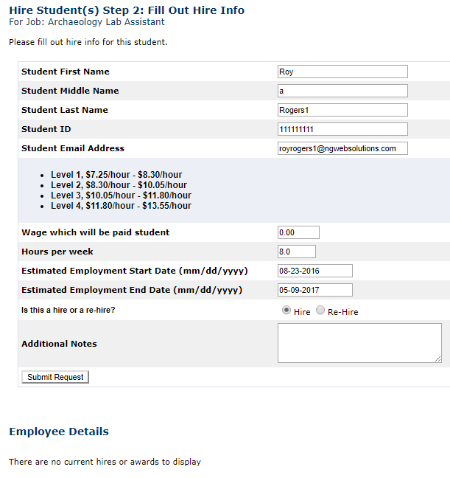
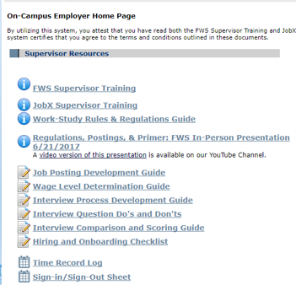
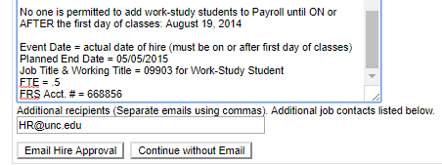
Students hired without authorization through JobX will have all earned wages retroactively charged to the hiring department and the department may be removed from the FWS program
Notes:
Insert photos of wage guide and posting for starred information

Slide 30
To Release Candidates From Consideration

Slide 32

Onboarding

Slide 33
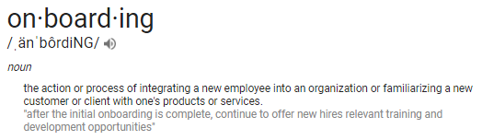
Onboarding
FWS Training
  Proof student completed FWS Training
Human Resources
  Completion of employment verification and payroll enrollment
Supervisor Training
  Completion of required operational/safety training
  Job-specific onboarding process

Slide 34
Onboarding-FWS Training
FWS Training
  Student needs to supply 2 items to supervisors, both from the Sakai site: Federal Work Study Student Training (https://sakai.unc.edu/portal/site/d678e51c-b164-4055-ab28-e6a78f6ca53e)
  A signed copy of the FWS Training Certificate Form
  A copy of the students training assessment with a score of 10/10

Slide 35
Onboarding-Human Resources
Human Resources
  Students need to meet with your HR Officer to complete
    I-9 verification
    Federal payroll withholding
    NC payroll withholding
    Direct deposit enrollment
  FWS recommends setting up the appointment for the student & letting the student know that they’ll need to bring employment documentation from home (e.g. driver’s license and social security card).

Slide 36
Onboarding-Supervisor Training
Supervisor Training
  Consists of 2 components
  University-required training
    TIM (Kronos) Training
    Safety/Hazard Training
  Supervisor-specific training
    Tour of the workplace
    Introduction to coworkers
    Explanation of how to use equipment
    Discussion of expectations

Slide 37

Time & Payroll Tracking

Slide 38
Time Tracking
Why is it important?
  Student hours are capped by Federal & UNC regulations
  Negative correlation between student success and working above allowed hours
  Documented downward spiral pattern for academic success and steady work when students exceed work hour limits
  Supervisors required to certify hours for payroll
  Excess hours worked can be an audit finding
  Repeat violations can be cause for removal from the program

Slide 39
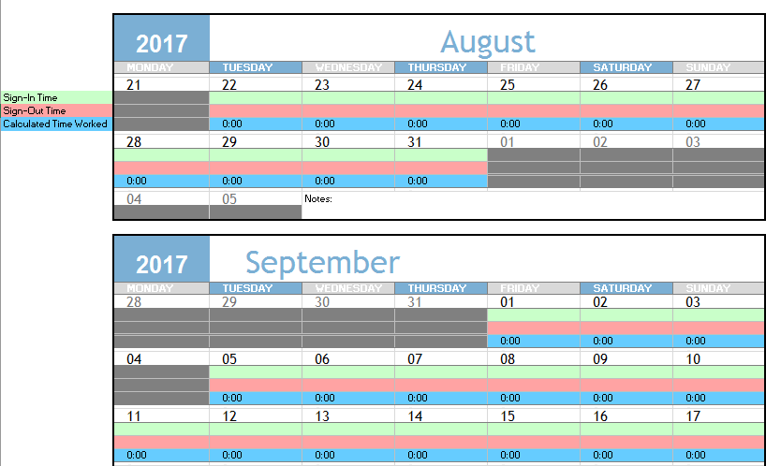
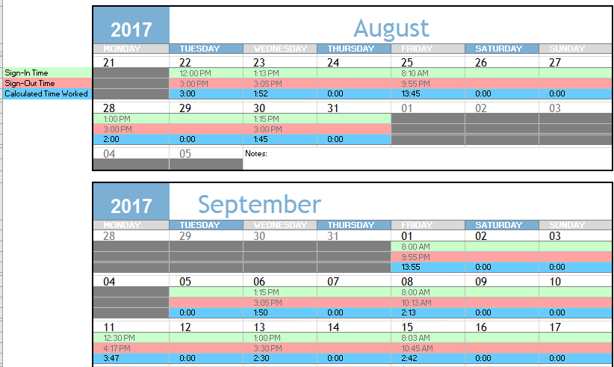
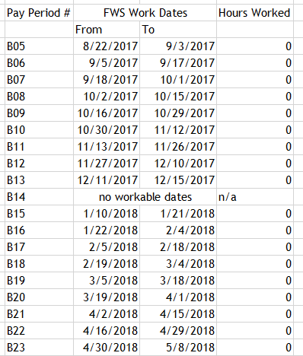
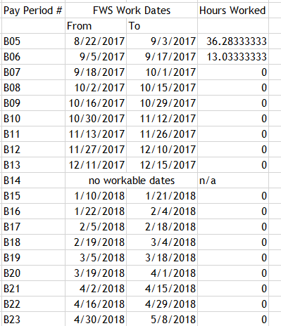
Time Tracking Options
TIM with certification
Pen and Paper
Self-made tracker
Email and verify
Centralized time tracker

Slide 40
Payroll Tracking
Why is it important?
  Student hours are capped by Federal, State, & UNC regulations
  Supervisors are responsible for ensuring compliance with these regulations
  Receiving excess pay is reportable to the University and Dept. of Education
  Overearns can result in audit findings
  Repeat violations can be cause for removal from the program

Slide 41
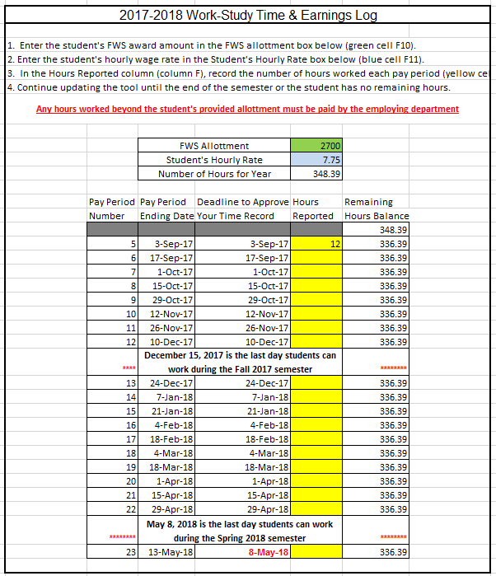
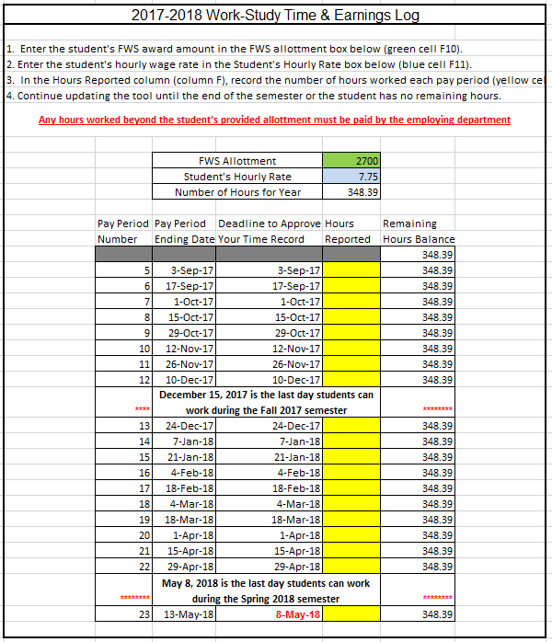
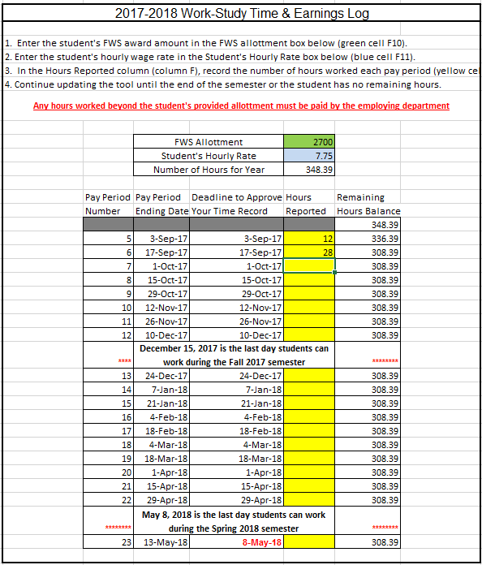
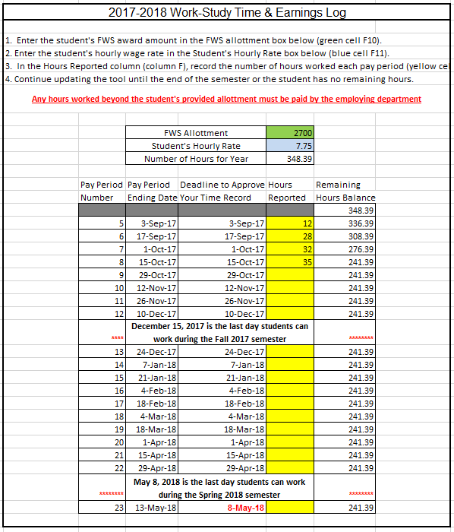
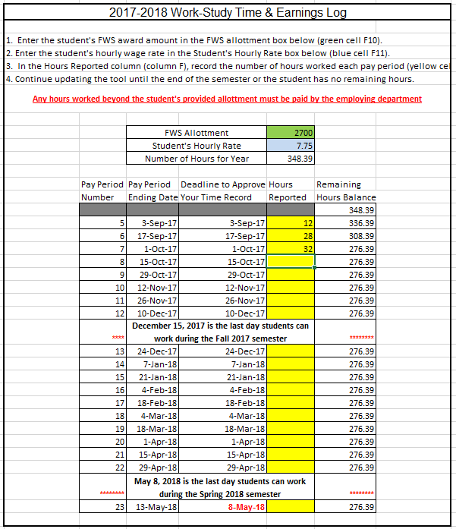
Payroll Tracking Options
Pen and Paper
Build your own spreadsheet
Reactive (FWS comms/reports)
Tracking tool

Slide 42




Slide 43
JobX: Required Questions
Update prevented question removal regarding prior work experience
Issue has now been resolved
JobX Job Review & Applicant Status
All pending job reviewed completed with 850 distinct positions posted as of 7/25/18
Student Access & Hiring
Featured Jobs
Students gain access on 8/1
Supervisors can begin hiring on 8/2
Do not hire students in Connect Carolina with first hiring in JobX
Remember to collect FWS Student Training documents (certification and test scores)
Will list open job(s) & a brief overview of the position on the JobX Student page
Jobs will be rotated on a regular basis
A separate featured job will be posted on the FWS Desk.
If you have additional materials you’d like to distribute, we’ll be happy to display them at the Desk.
FWS awards provided to 4,939 students as of 7/19/17, an increase of ~900 students over last year

Slide 44
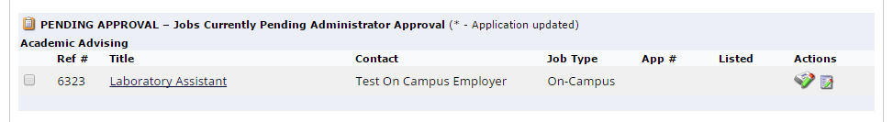
*: Editing Posted Jobs
To edit Job Descriptors or Job Logistics
To edit Job Application
***Please note that updating any portion of the job posting will require the position to be reviewed again.***

Slide 45
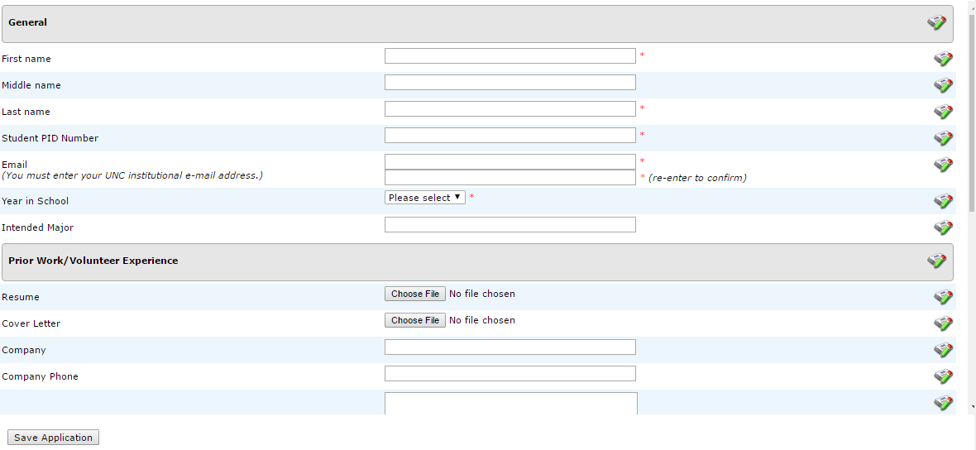
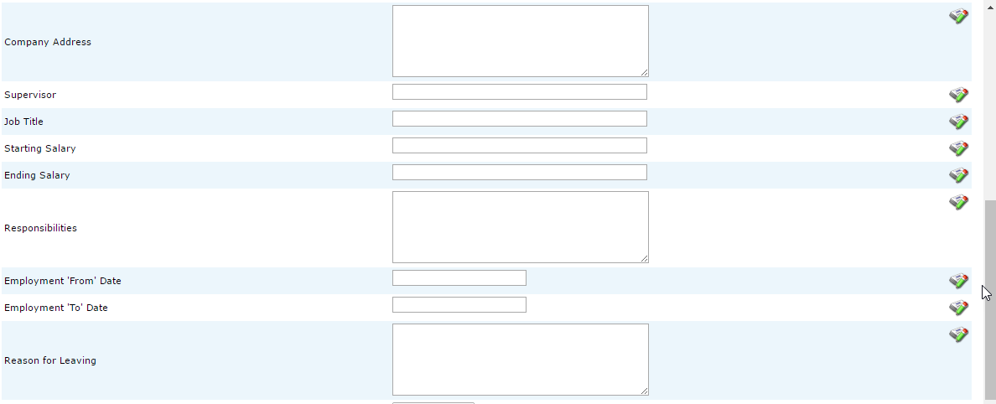
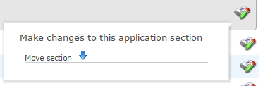
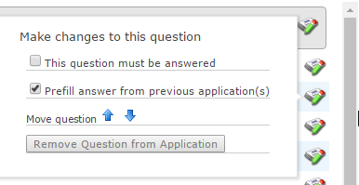
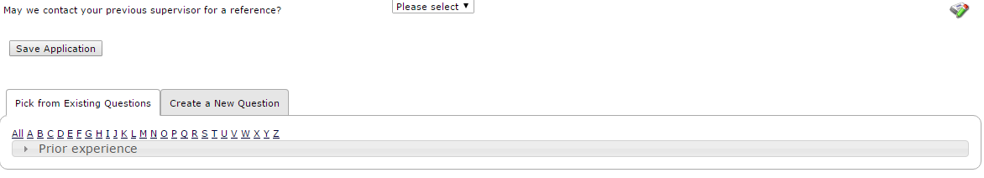
9: Complete Job Application Section
Common Application Questions
  General
  Prior Work/Volunteer Experience
Custom application questions

Slide 46
JobX: Required Questions
Update prevented question removal regarding prior work experience
Issue has now been resolved
JobX Job Review & Applicant Status
All pending job reviewed completed with 850 distinct positions posted as of 7/25/18
Student Access & Hiring
Featured Jobs
Students gain access on 8/1
Supervisors can begin hiring on 8/2
Do not hire students in Connect Carolina with first hiring in JobX
Remember to collect FWS Student Training documents (certification and test scores)
Will list open job(s) & a brief overview of the position on the JobX Student page
Jobs will be rotated on a regular basis
A separate featured job will be posted on the FWS Desk.
If you have additional materials you’d like to distribute, we’ll be happy to display them at the Desk.
FWS awards provided to 4,939 students as of 7/19/17, an increase of ~900 students over last year

Slide 47
JobX: Required Questions
Update prevented question removal regarding prior work experience
Issue has now been resolved
JobX Job Review & Applicant Status
All pending job reviewed completed with 850 distinct positions posted as of 7/25/18
Student Access & Hiring
Featured Jobs
Students gain access on 8/1
Supervisors can begin hiring on 8/2
Do not hire students in Connect Carolina with first hiring in JobX
Remember to collect FWS Student Training documents (certification and test scores)
Will list open job(s) & a brief overview of the position on the JobX Student page
Jobs will be rotated on a regular basis
A separate featured job will be posted on the FWS Desk.
If you have additional materials you’d like to distribute, we’ll be happy to display them at the Desk.
FWS awards provided to 4,939 students as of 7/19/17, an increase of ~900 students over last year

Slide 48

September
  Overearning prevention workshop
  Training and development
  Evaluation and feedback
  Date TBD. Can not reserve space until after 9/7.

