Slide 2
Federal Work-Study Supervisor Training
Session 3: Overearning Prevention, Evaluations, &
Student Development
27 October 2017
Office of Scholarships & Student Aid
University of North Carolina at Chapel Hill

Slide 3
Overview of Today’s Session
Overearnings
What they are
How they happen
How to prevent them
Evaluation
Purpose
Timelines
Tools
360 Reviews
Student Development
Projects, Skills, Meetings, & Mentoring

Slide 4
Overearning Evaluation & Prevention

Slide 5
Jargon Time
Overaward – A disbursement of financial aid beyond a student’s calculated need resulting in violation of federal regulatory limits
Overearn – A type of overaward caused by payroll earnings through the FWS program in excess of a student’s allotted work-study amount

Slide 6
Payroll/Earnings Tracking
Why is it important?
Student hours & total earnings are capped by Federal, State, & UNC regulations
Supervisors & students are responsible for ensuring compliance with these regulations
Receiving excess pay (an overearn) is reportable to the University and Dept. of Education and can result in audit findings
Repeat violations can be cause for removal from the program

Slide 8
Overearns and Timing
FWS pays every two weeks, for the preceding fourth & third week.
Link to schedule: http://finance.unc.edu/files/2016/12/2017-Biweekly-Pay-Period-Schedule.pdf

Slide 10
Payroll Tracking Options
Reactive (FWS comms/reports)
Pen and Paper
Build your own spreadsheet
Tracking tool

Slide 12
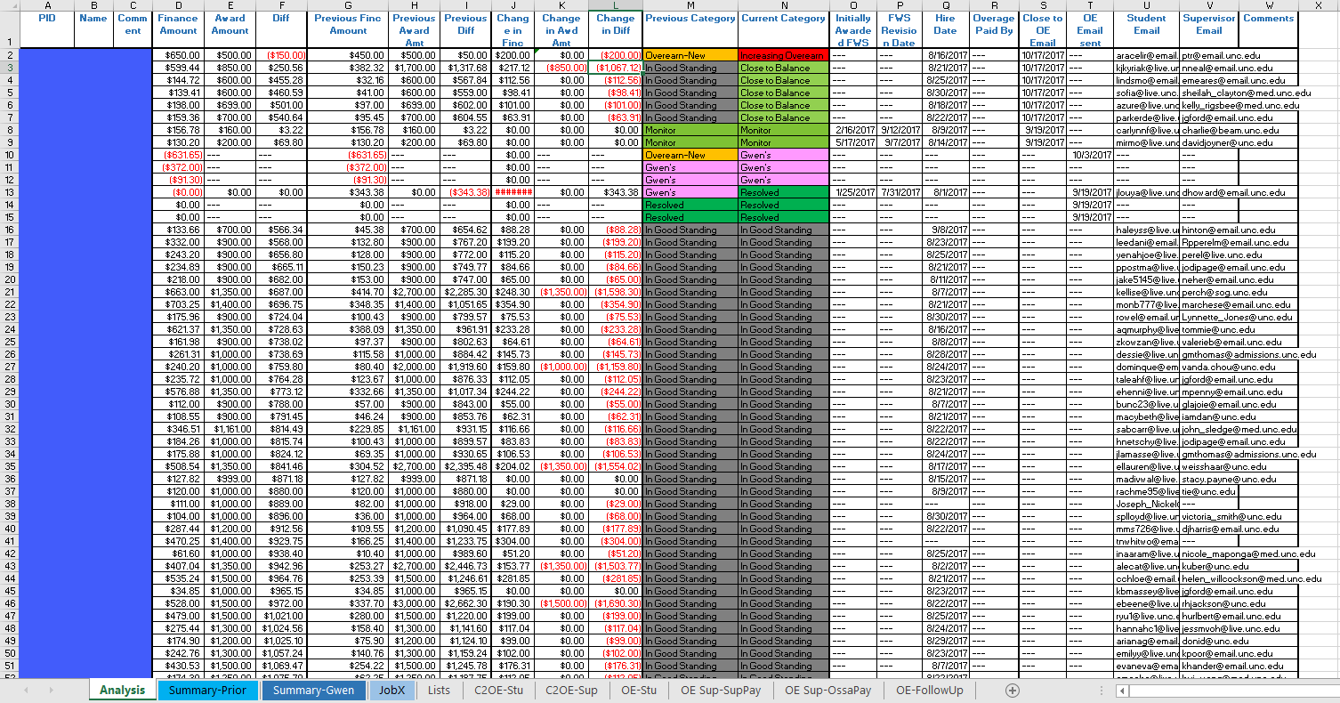

Slide 13
Previous Balances
(Prior Reconciliation)
Employment Data
(JobX)
Payroll Data
(Accounting)
Reconciliation Workbook
Communications
to Student & Supervisor
If earnings near limit
Connect Carolina
(Accounting)
If earnings over limit
If overearn isn’t fixed
Excess earnings returned to FWS fund via PAAT entry ASAP

Slide 14
January Update
12/15
1/22-1/26

Slide 15
Payroll Tracking Options
Reactive (FWS comms/reports)
Pen and Paper
Build your own spreadsheet
Tracking tool
Earnings in Pay Period | Total Earnings | Balance
0 | 0 | 2700
150 | 150 | 2550
167 | 317 | 2383
123 | 440 | 2260

Slide 16
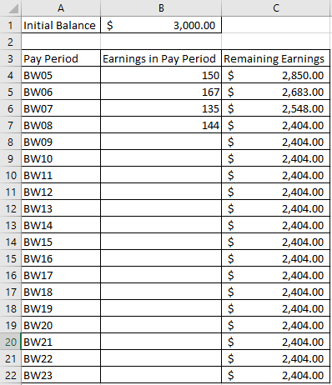
Payroll Tracking Options
Reactive (FWS comms/reports)
Pen and Paper
Build your own spreadsheet
Tracking tool

Slide 17
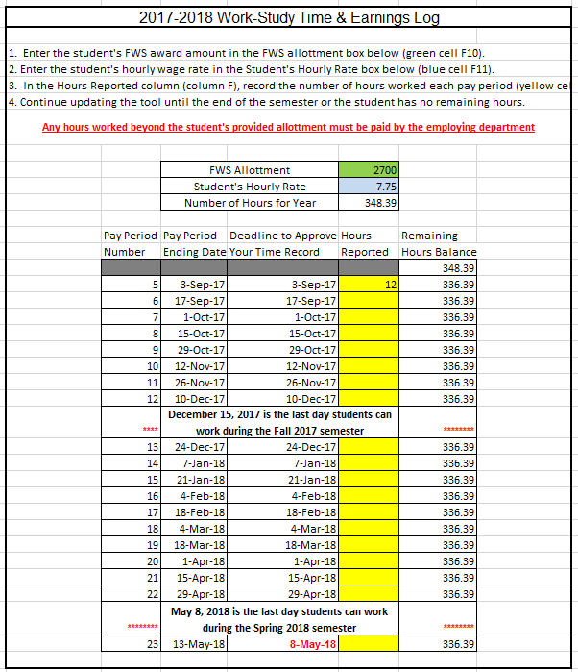
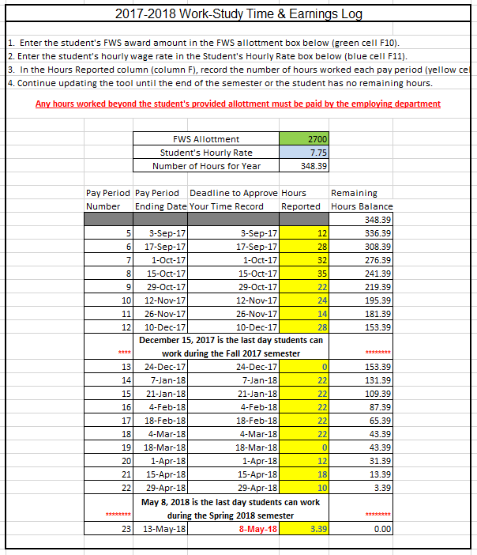
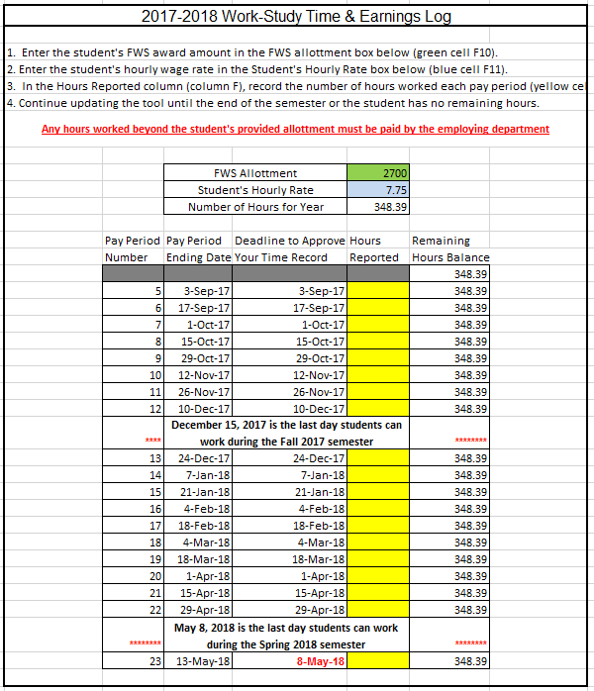
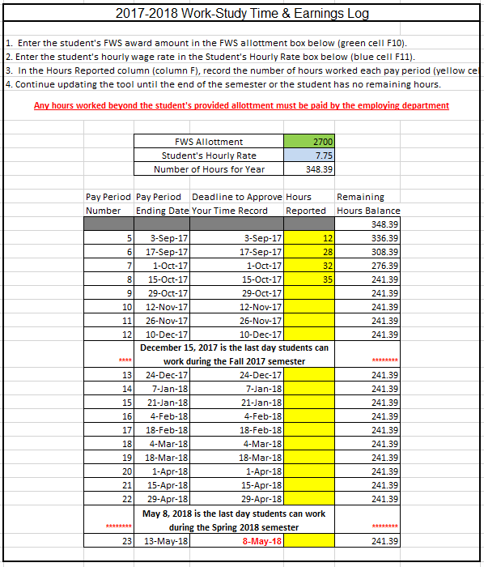
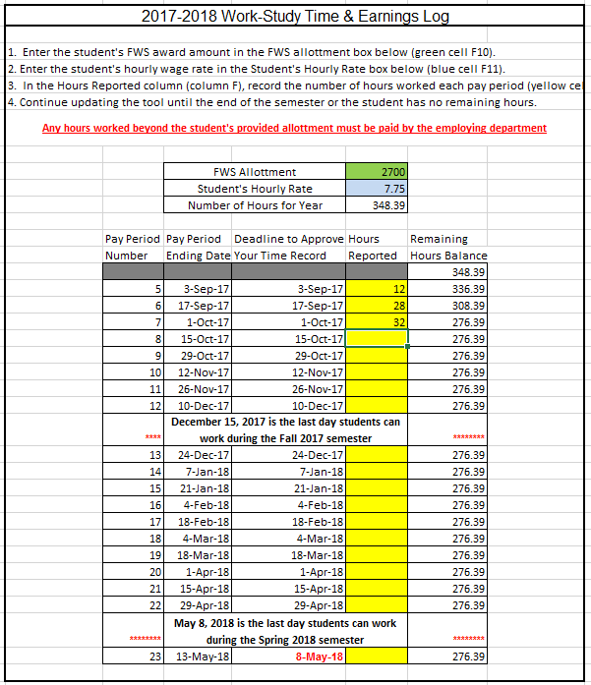
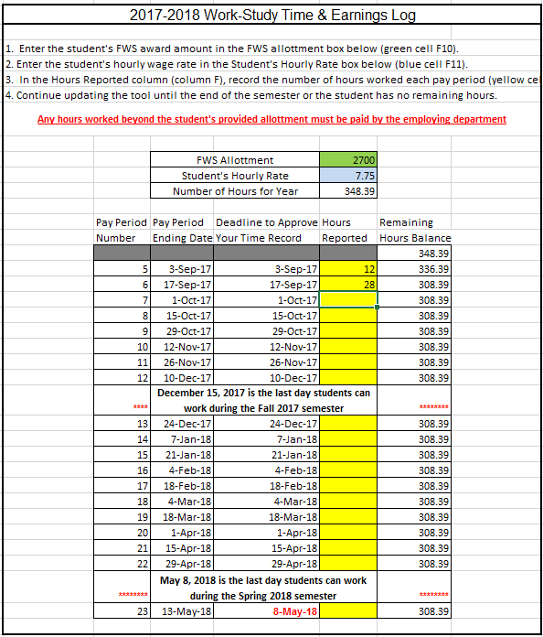
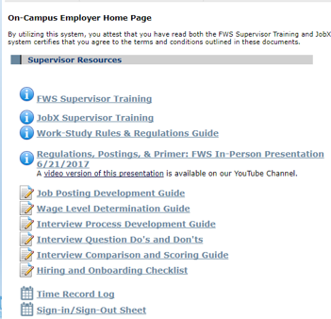
Payroll Tracking Options
Reactive (FWS comms/reports)
Pen and Paper
Build your own spreadsheet
Tracking tool
***The tracking tool can also be used to plan work hours in advance!***

Slide 18
Changes in FWS Award Amount
COA – EFC = NEED
Need < Need-Based Aid (NBA)
Work-Study is a form of NBA
Revision Notices are sent weekly on Mondays.
Supervisors are not responsible for overearns caused by revisions before notification!
Overaward Zone
Need
COA
EFC

Slide 19
Evaluations

Slide 20
What is an Evaluation
What is an evaluation?
A in/formal review of employee’s performance over a given timeframe
A time to address areas of success or failure
An opportunity to set goals for future time periods
A chance for parties (supervisors & student) to define targeted areas for improvements
What isn’t an evaluation?
A judgment of the employee as a person
A one-way conversation
The best place to bring up issues for the first time
By itself, a reason for promotions or wage changes

Slide 21
What Does an Evaluation Entail
Ideally
Start semester by setting goals and expectations
Check in regarding milestones and periodically
Formally provide feedback during evaluation at set key times
Realistically
Meet with student to talk candidly about their performance, your expectations, any discrepancies, and ways to make all items align

Slide 22
When Do I Evaluate?
Options
Annual
Semesterly
Bi-semesterly
Monthly
Bi-monthly
Weekly
Daily
Recommended
After first 3-6 weeks
Informal
At midpoint of each semester
Informal
At end of each semester
Formal

Slide 23
What Tools Are available
UNC Human Resources
Performance Management Page
Contains Toolkit which includes:
Evaluation Presentation
SMARTER Goals Worksheet
Institutional Goals
Much, much more!
*Geared towards full-time staff*
UNC FWS Evaluation Form
Employee Information
Core Values Evaluation
Position-Specific Evaluation
Overall Evaluation and Rating
Future Goals
Signatures
Live Evaluation Form
Example Evaluation Form

Slide 24
The 360 Review
360 degree feedback allows you to use multiple raters such as supervisors, peers, direct reports, subordinates and external raters (e.g. clients) to leave feedback on an employee. The feedback is often used as a benchmark within the employee’s development plan. In a team-focused atmosphere, 360 degree feedback surveys can be very effective. It lets the employee know how his/her team members view the effectiveness of their performance.
Live Evaluation Form

Slide 25
Student Development: From Transactional to Transformational

Slide 26
Mentoring as defined by UNC HR’s Mentoring Services
Mentoring is an organizational practice in which people come together to transfer or develop a specific skill set. In the mentoring process, transformative learning and leveraging of experiences become gateways to individual and organizational growth and development. The actual practice of mentoring varies with the people participating in the process.
Mentoring takes place at all levels of an organization. Whether people engage in traditional one-on-one mentoring partnerships or engage in peer and team mentoring, the mentoring process invites participants to grow into their full potential, enriching the workplace and helping an organization improve. These partnerships can be conducted face-to-face or in a variety of forms, including distance learning, videoconferencing, emailing, and phone calls.

Slide 27
Benefits of Mentoring as defined by UNC HR’s Mentoring Services
Increased competency levels in accomplishing crucial work for departments and the University.
Personal and direct contributions to the career development of talented employees.
Accelerated leadership development to sharpen coaching, management, and communication skills (both for the mentor and the mentee), vital skills for successful leadership practices.
Increased organizational commitments and job satisfaction, demonstrated as renewed interest and vigor for work responsibilities which benefit the larger institution.
Heightened individual and organizational learning.
Stronger and more cohesive teams.
Takeaway: Mentoring leads to better employees who do more & better work which provides you with additional time to pursue improvement opportunities (upward spiral).

Slide 28
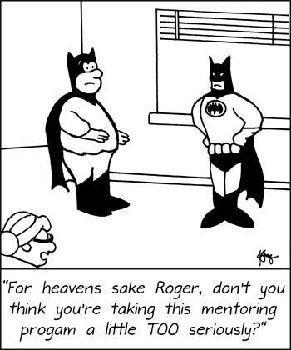
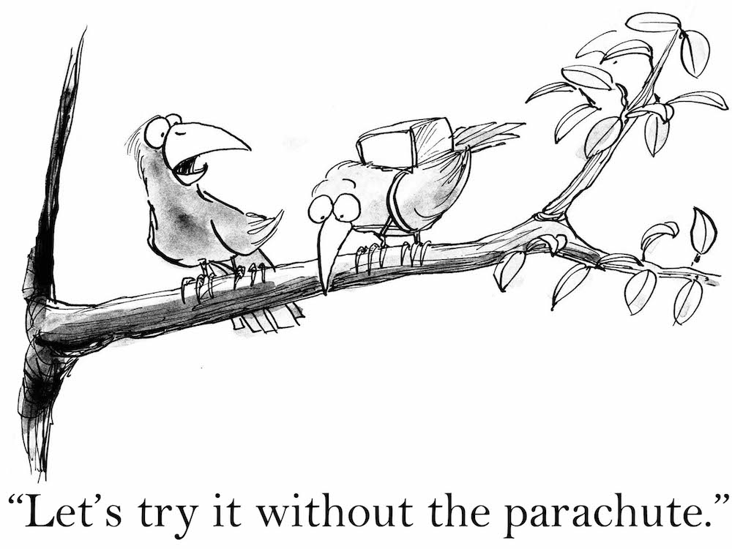
Mentoring Recommendations
Offer, don’t require
Identify goals & expectations of mentoring relationship
Establish communication guidelines
Evaluate areas of improvement for student
Provide feedback & evaluation regularly
Review goal progress at set times
Be encouraging and have fun

Slide 29
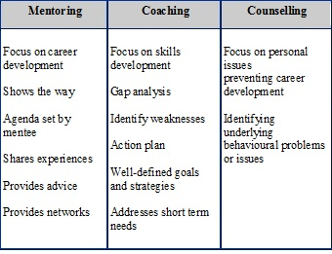
Mentoring Alternatives

Slide 30
Other Ways To Develop Your Students
Projects
Research
Benchmarking
Operational Analysis
Customer Satisfaction
Improvement
Office/Lab Manual
Grant-Writing
Marketing/Recruiting Materials
Social Media Presence
Repeatable or Time-Series
Performance Assessment
Set up steps for new FWS jobs
Skill Development
Workshops
Online Webinars/Training Videos
Articles, Manuals, Websites
Peer Training
Cross Training
Development Meetings
1:1
Office/Team/Lab meetings
Job Shadowing
External Stakeholders
Planning Meetings

Slide 32
Updated JobX Fields
New optional fields for hours/day for each day of the week
Spring Jobs
Open for submission and being reviewed multiple times every week
Please make sure to create new Spring-only jobs as current Academic Year (i.e. Fall/Spring jobs can not be approved.
Feel free to copy and paste content from Fall/Academic Year jobs

Slide 33
Site Visits
NO DISCIPLINARY ACTION IS TAKEN BASED ON FINDINGS
Job/Career Alignment & Recruitment
Goal: to better align current FWS positions with jobs students enter upon graduation
Find gaps between best practices and current operations
Develop promotional materials for future FWS students and potential donors
Better acquaint FWS Staff & Supervisors/Students
Currently performing a gap analysis and will be reaching out to employers in underrepresented areas
Half-hour process being conducted by full-time and student members of the FWS team
Consists of questions with supervisor/FWS Student, interview of student, & photos
Goal is three-fold
Taking volunteers for Nov./Dec.

Slide 34
Next Training Session
Repeat Session?
Overview of Annual Survey Results
Federal Regulations
Creating Jobs in JobX
Reviewing Applications
Interviewing & Evaluating Candidates
Hiring & Onboarding
Overearn Prevention
Evaluation
Student Development
Something New?
Qualtrix poll going out next week
?

